Slide 1
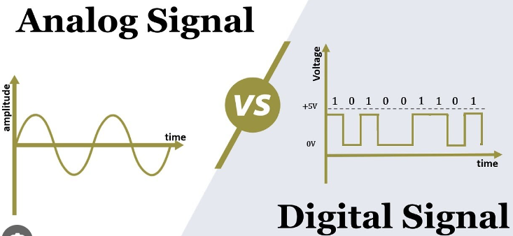
Introduction to Logic System Design
DIGITAL ELECTRONICS- Digital electronics is the study of electronic circuits that are used to process and control digital signals.
In contrast to analog electronics, where information is represented by a continuously varying voltage, digital signals are represented by two discrete voltages or logic levels.

Slide 2
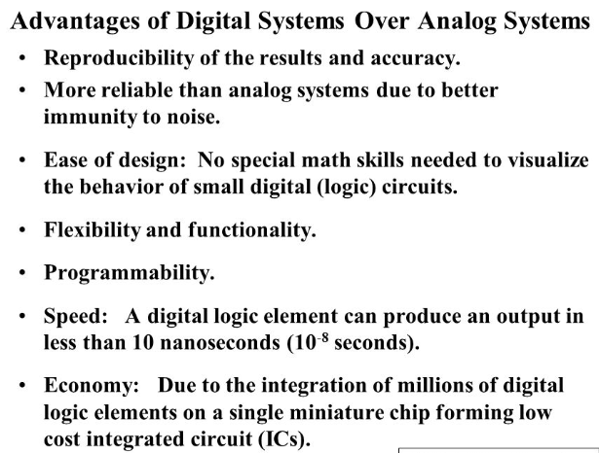
One major drawback in the implementation of digital technique is that, “the real world is analog, or most of the physical quantities are analog in nature”, so quantities have to be converted into digital form for processing.

Slide 3
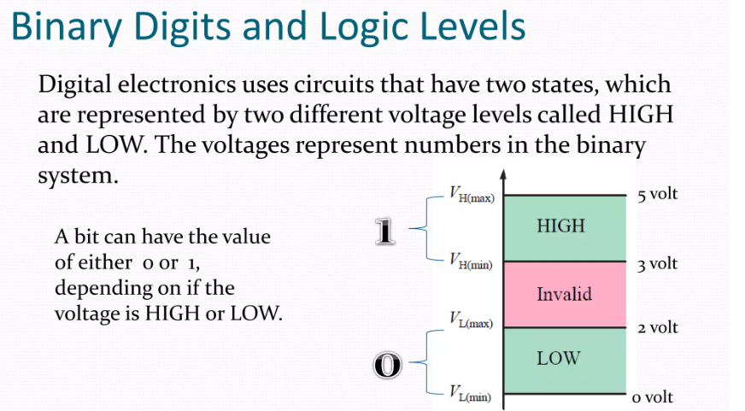

Slide 4
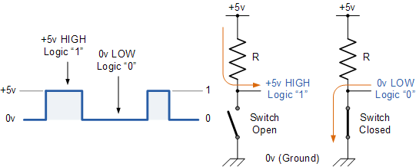
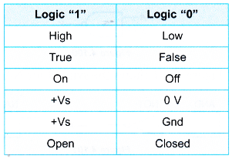
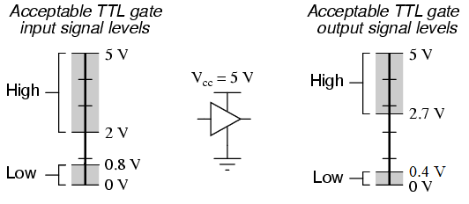
Logic ‘0’ and ‘1’
5V
(supply)

Slide 5
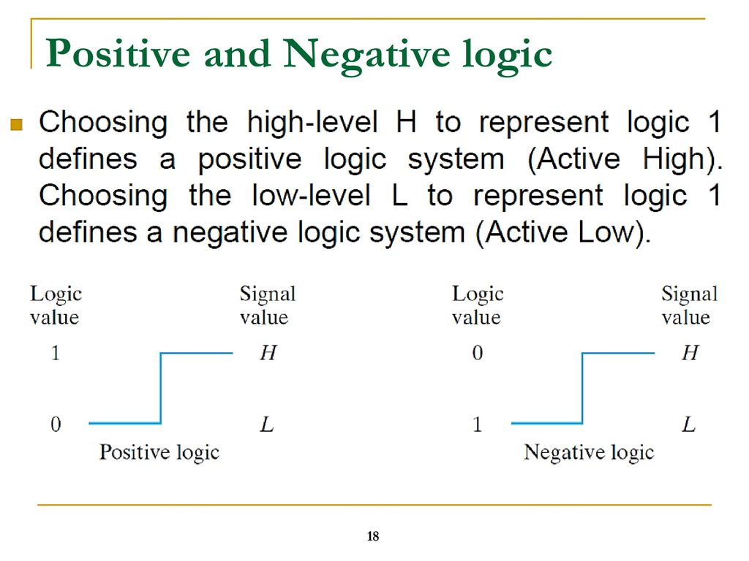

Slide 6
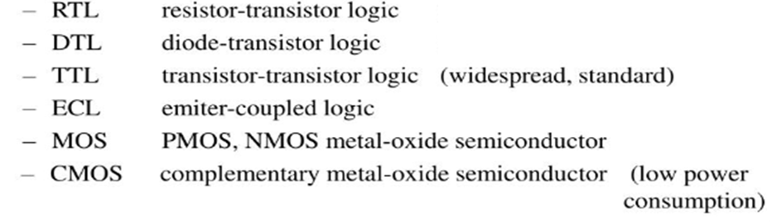
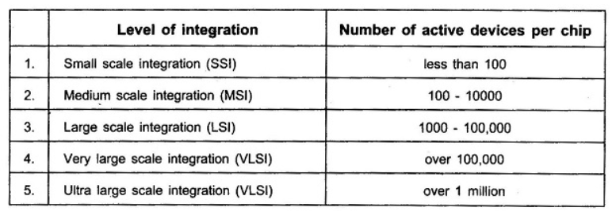
Technology used for the manufacturing of Digital IC…this is based on the design style and components used

